Slide 1
Lambda
Week 11 – Lambda Step-by-Step

Slide 2
Simple Site Storeage (S3)
Just an Internet location for any type of computer file you need
Save your vacation pictures
School notes
Web page resources (HTML, CSS, JS, images………)

Slide 3
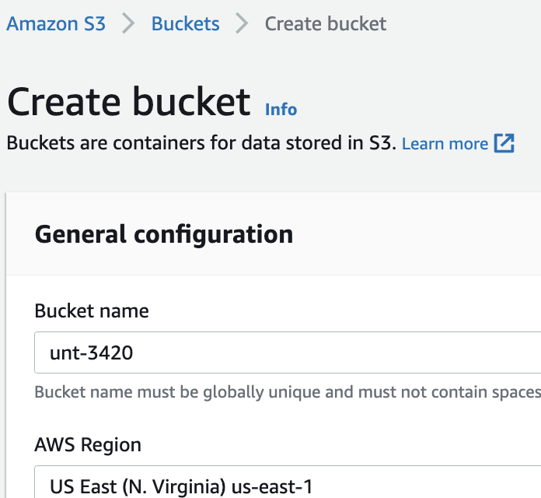
Create the Bucket
Choose a name
Choose your region
Review the other options
WORM
Encryption
Versioning

Slide 4
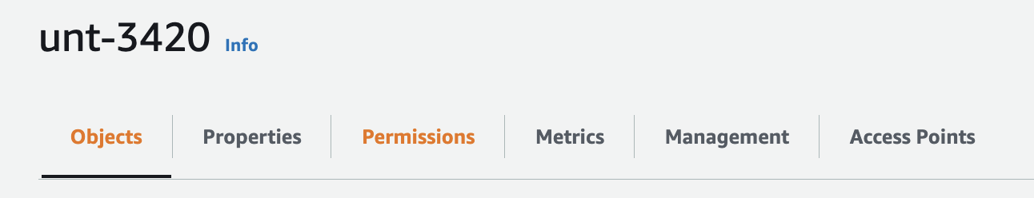
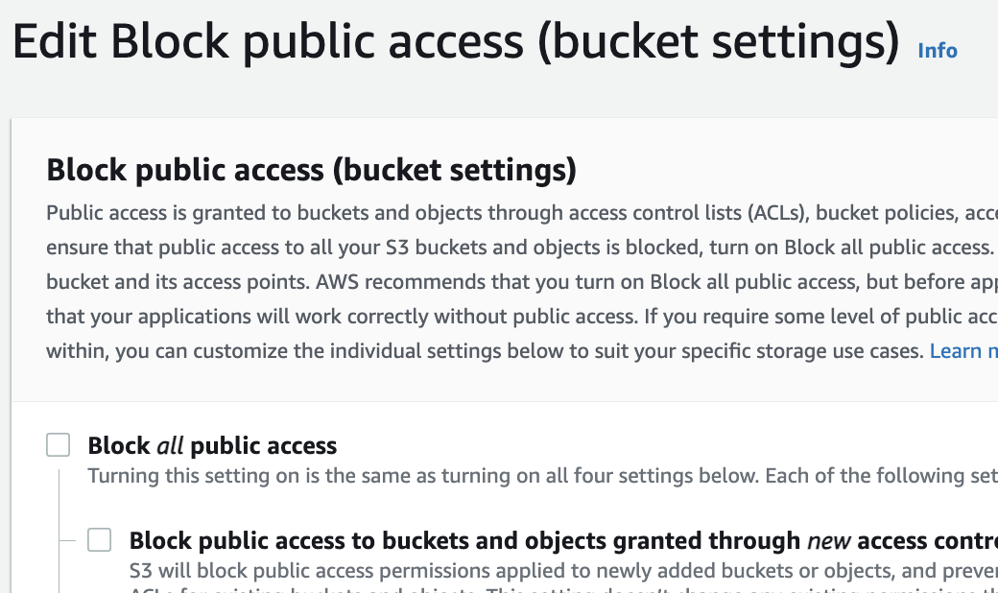
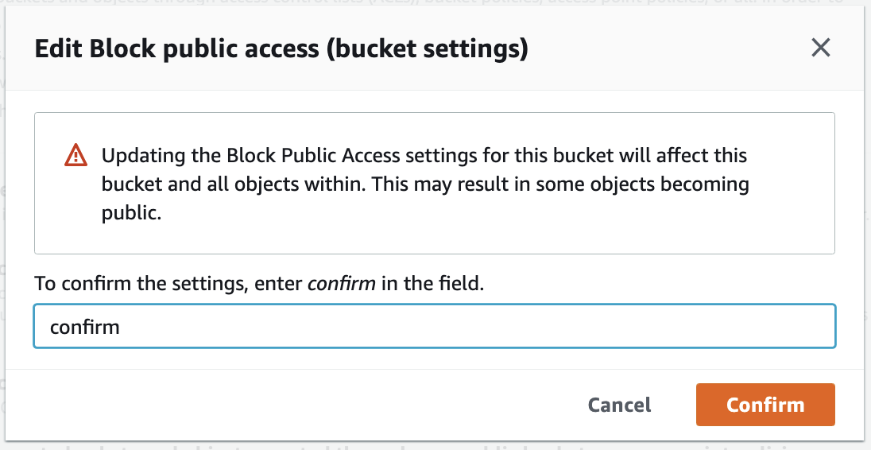
Permissions Make resources visible
The Default setting is to Block ALL public access
Uncheck the box and leave the rest of the boxes unchecked

Slide 5
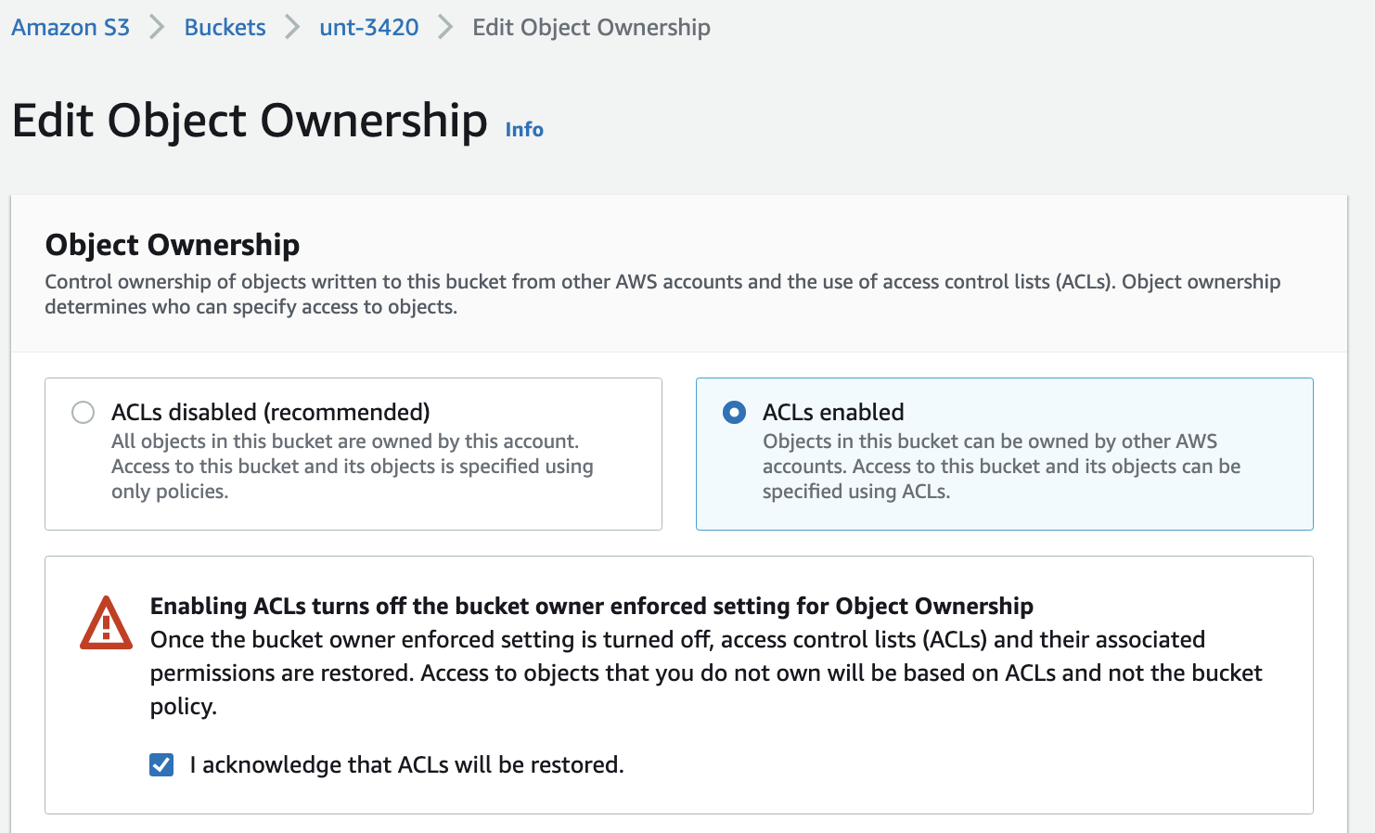
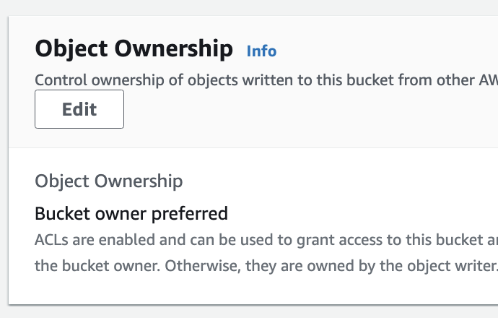
Permissions

Slide 6
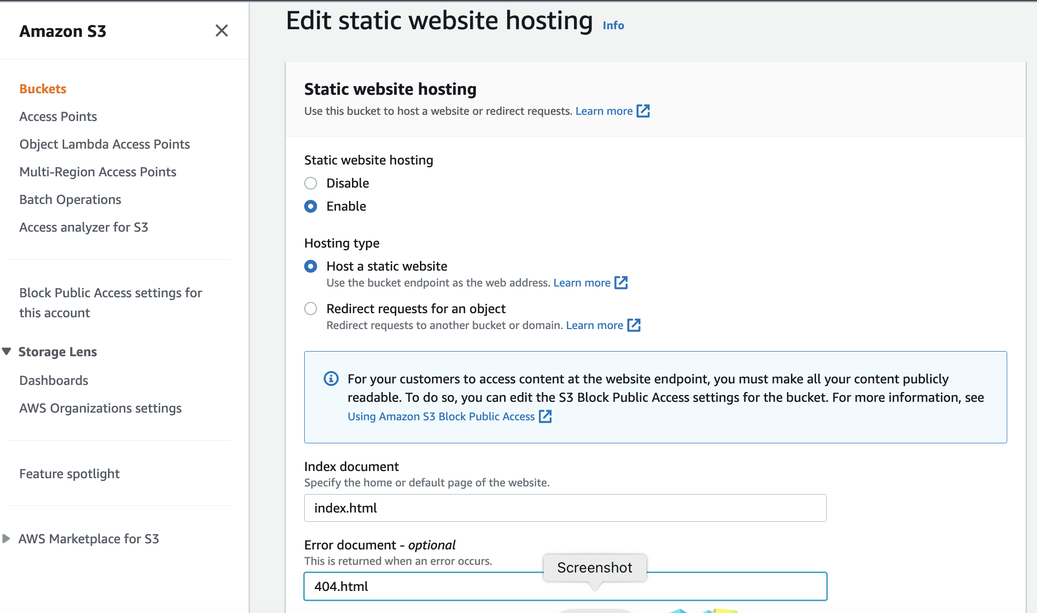
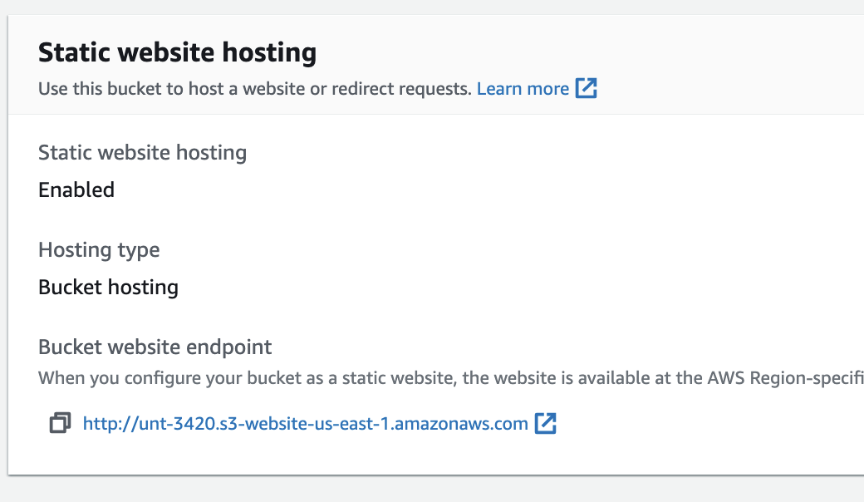
Make the resources visible
This looks a little different than the tutorial

Slide 7
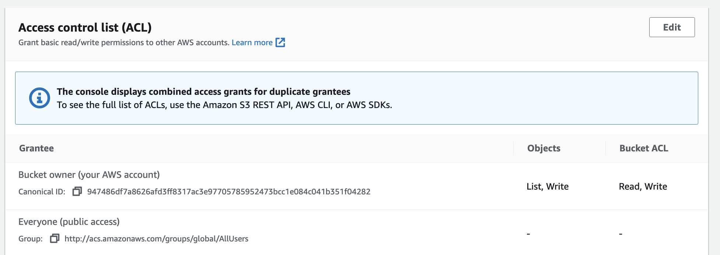
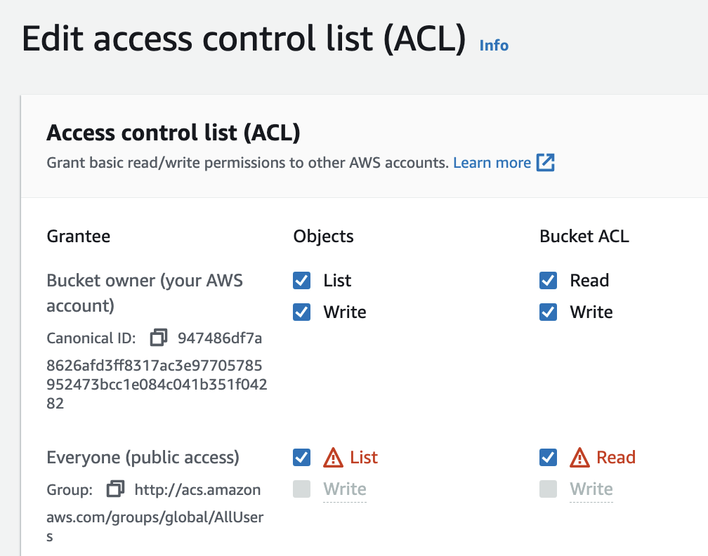
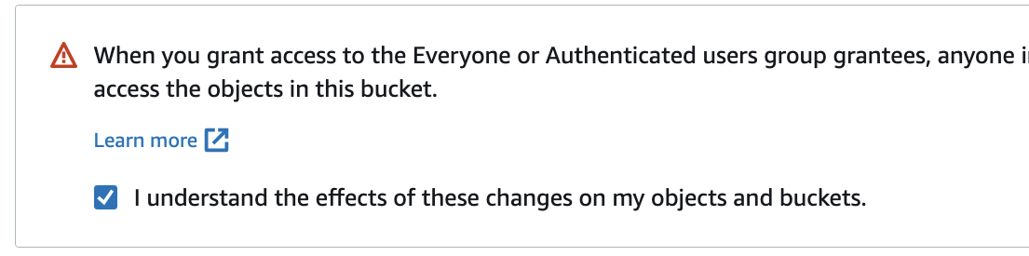
Permissions ACL

Slide 8
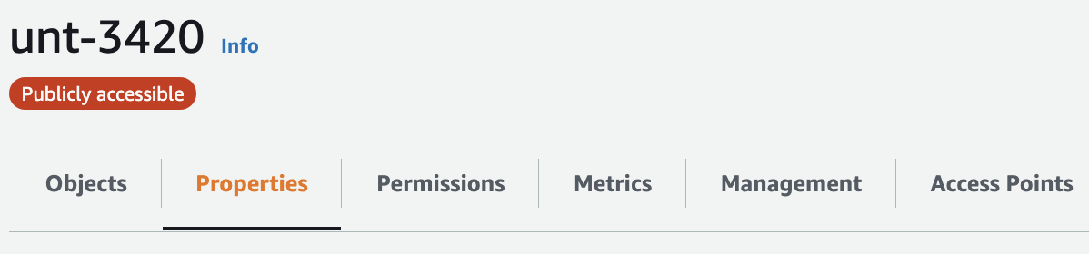
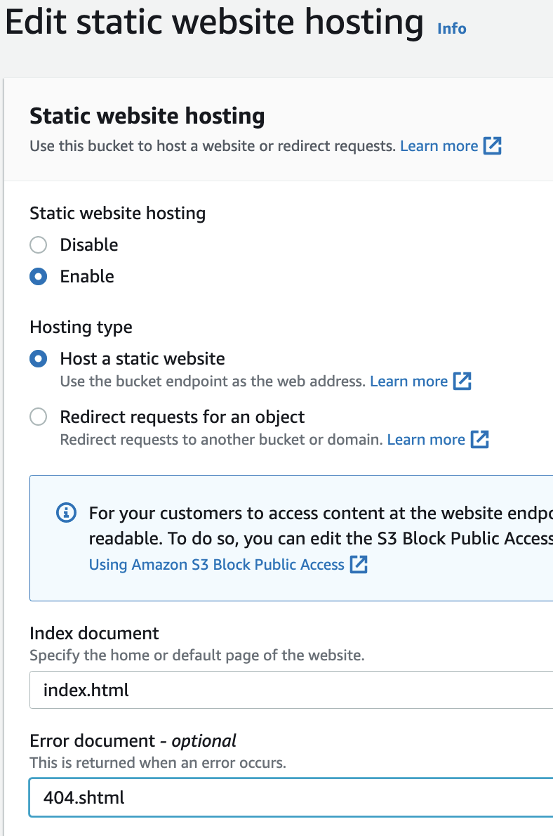
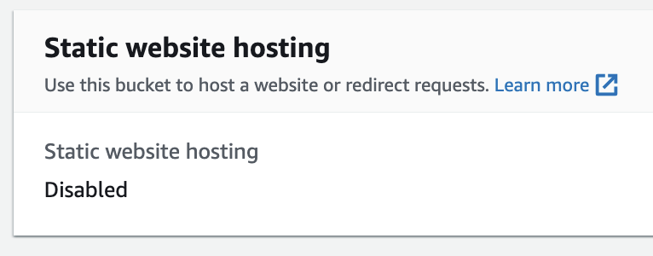
Properties Static Website Hosting

Slide 9
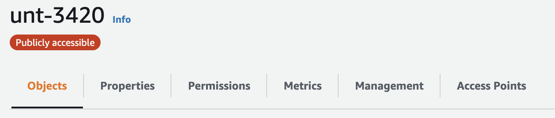
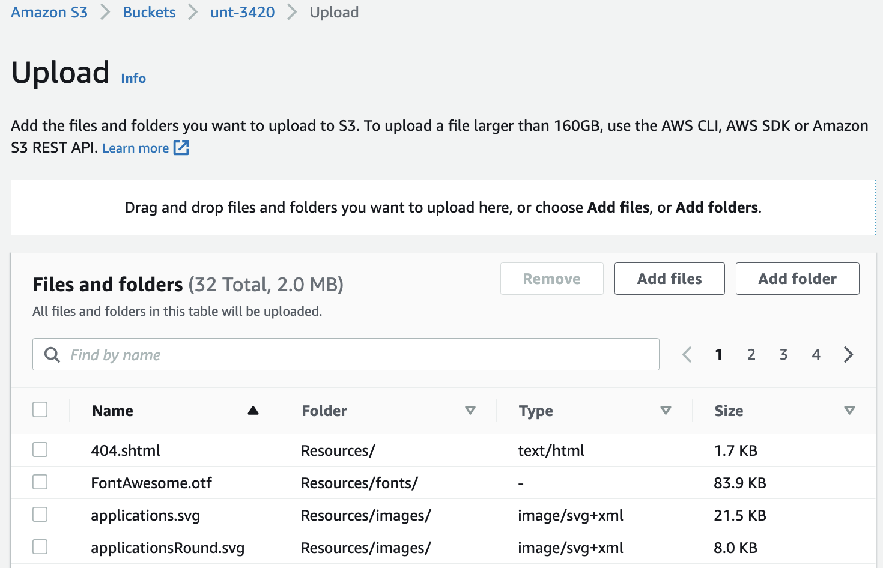
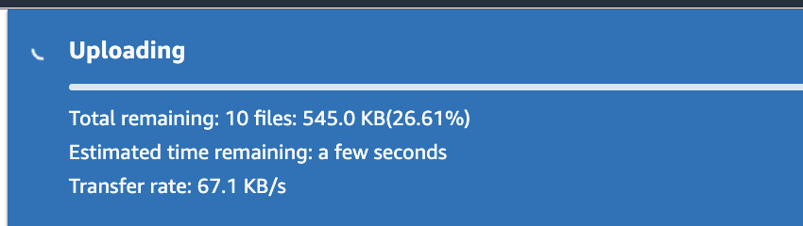
Objects Upload Files
Drag and Drop any files you would like to use

Slide 10
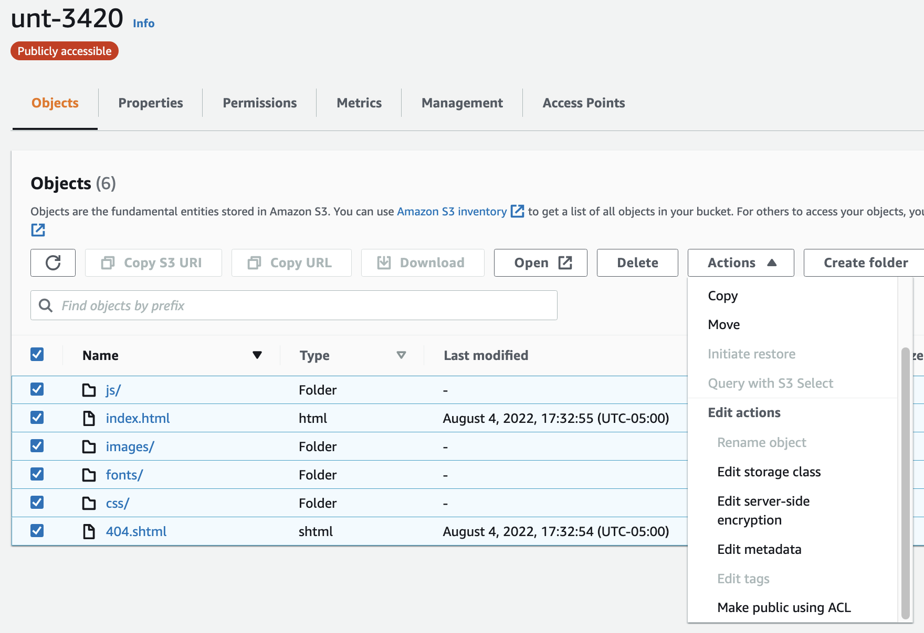
Objects Make Public

Slide 11
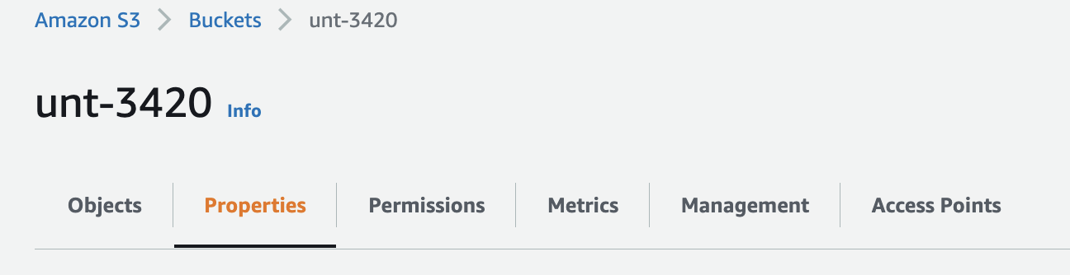
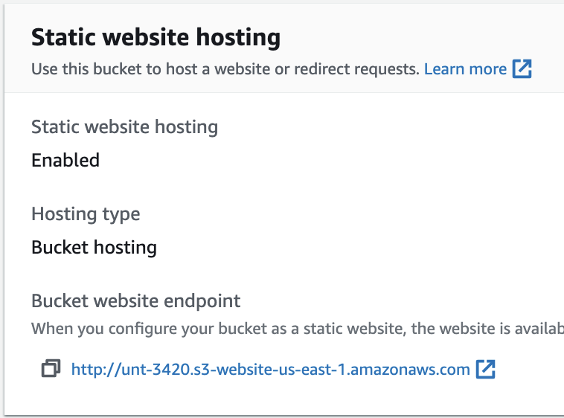
Now you have a URL
Go to Properties down at the bottom
Click on your URL
Your home page will be displayed in the browser

Slide 12
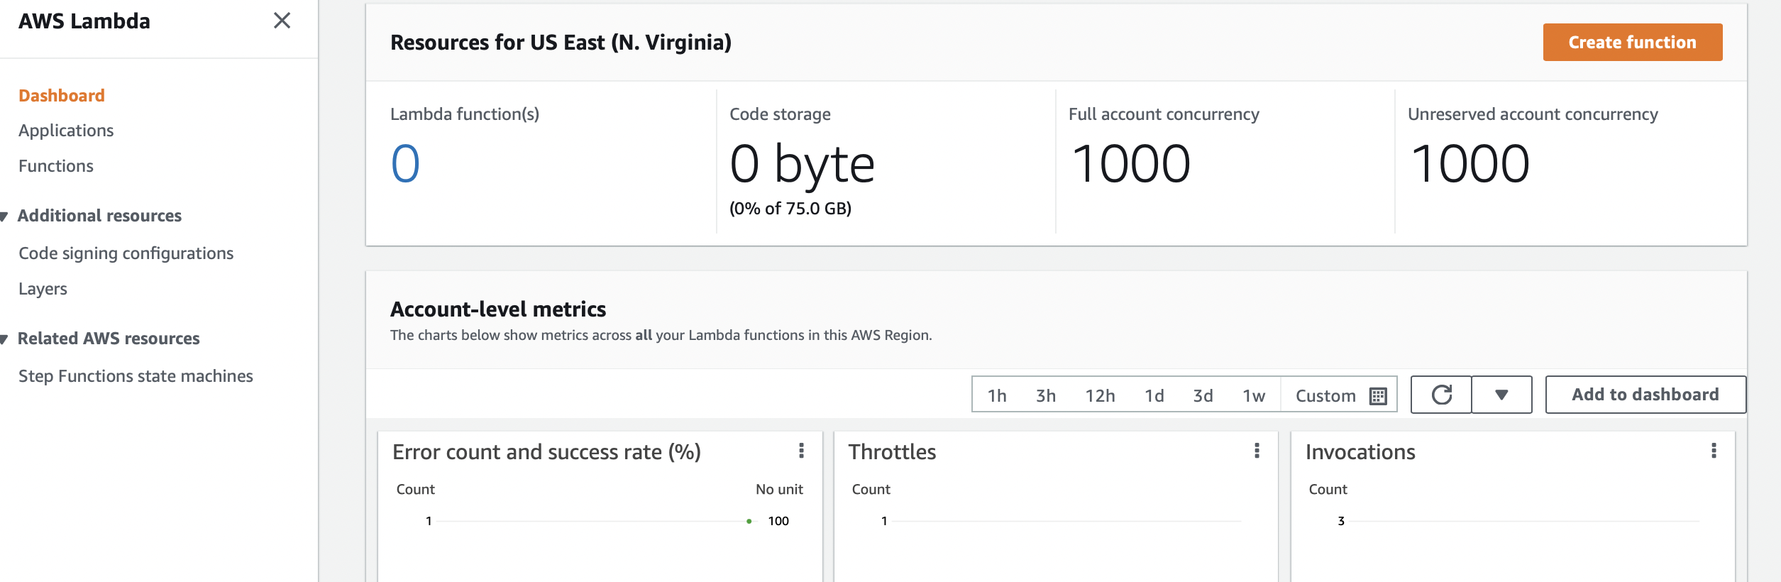
Create a Lambda Function

Slide 13
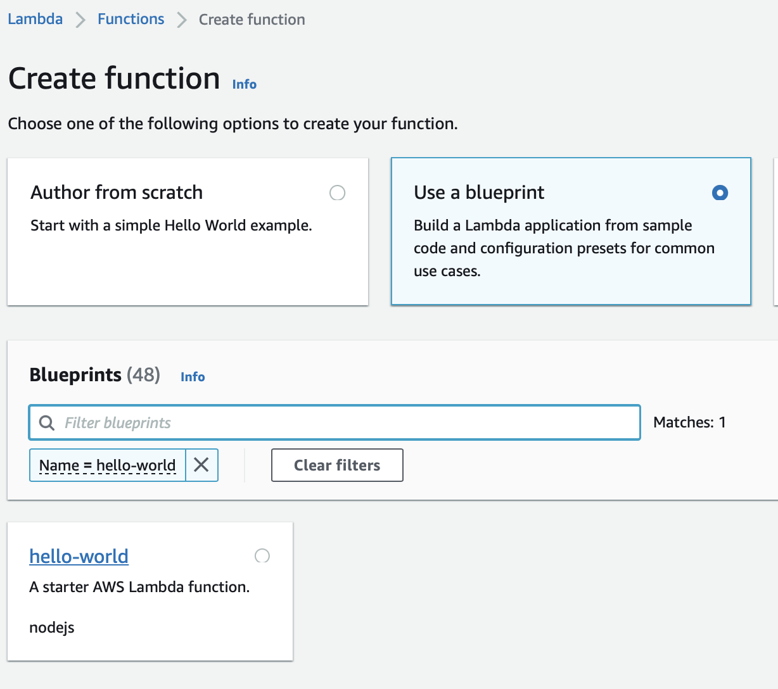
Lambda Blueprint
You search for many flavors of Lambda functions.
We want just a vanilla ‘Hello World’ example to start with
The lab says use python
We will use node.js

Slide 14
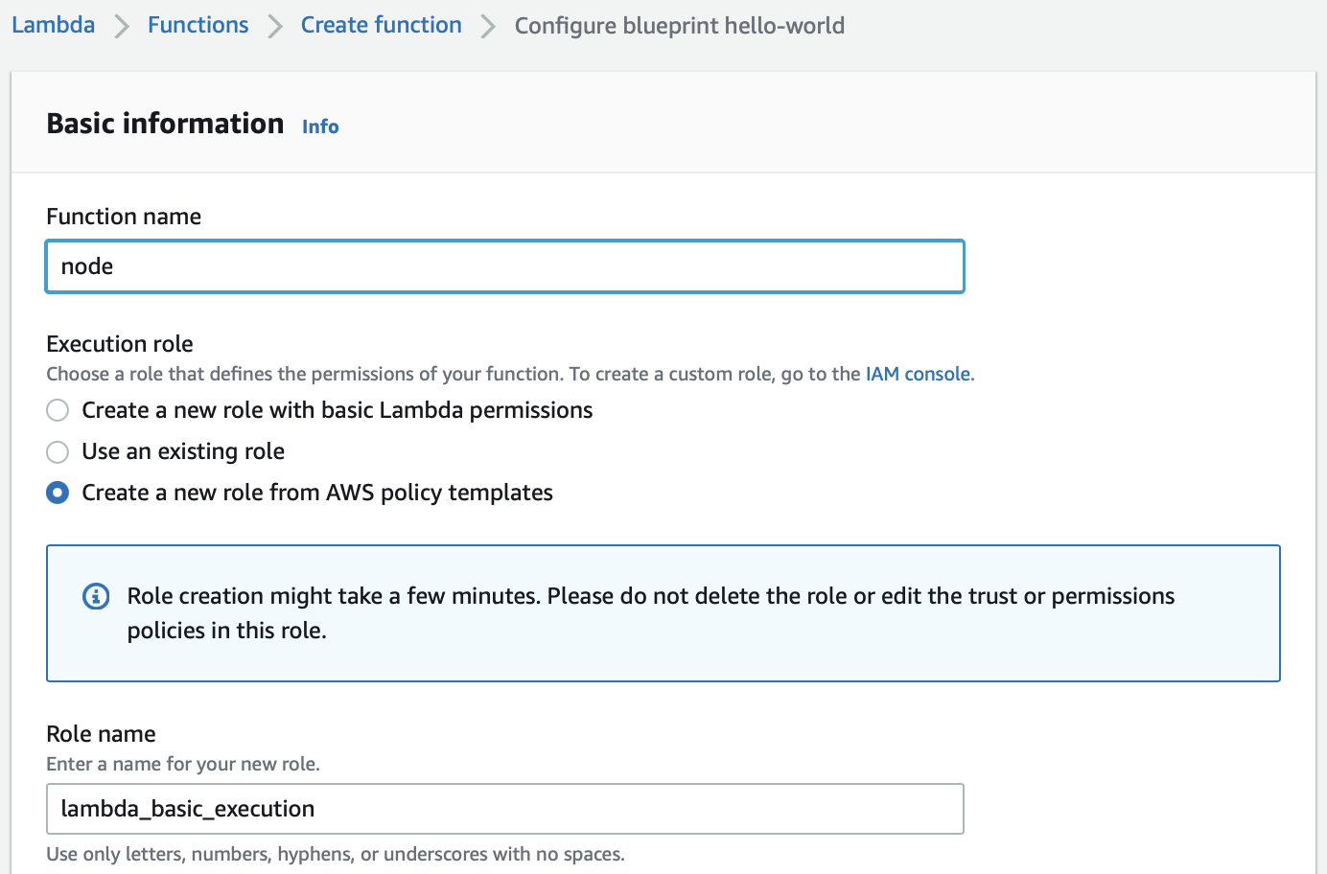
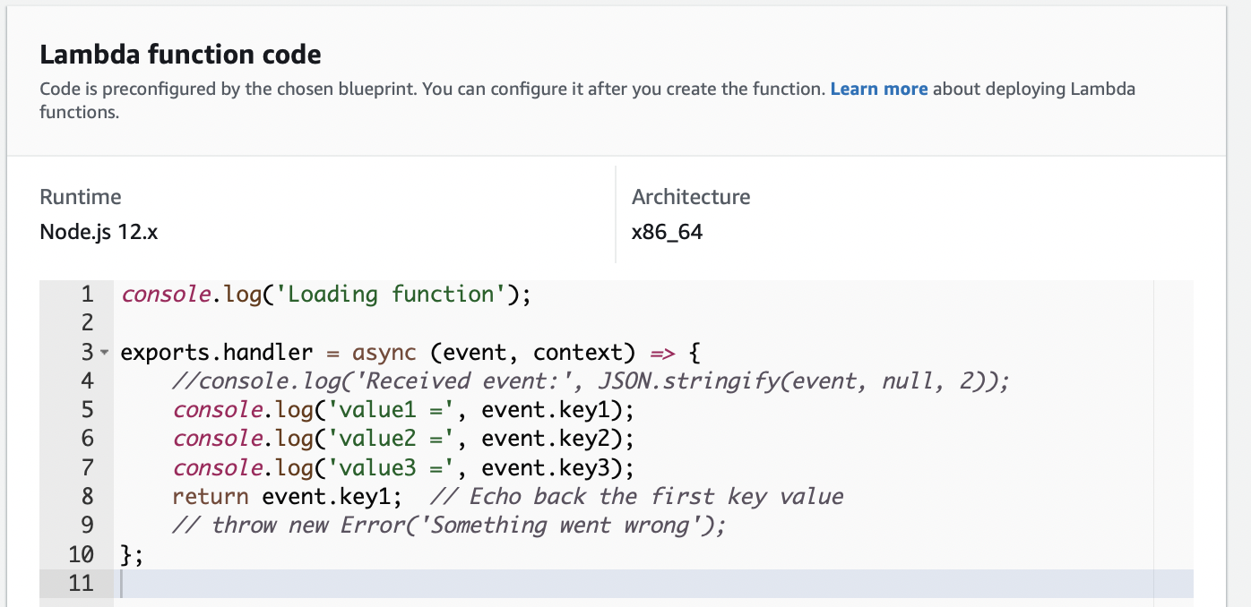
Each Lambda function will do a single job
Scroll lower to see the default start code

Slide 15
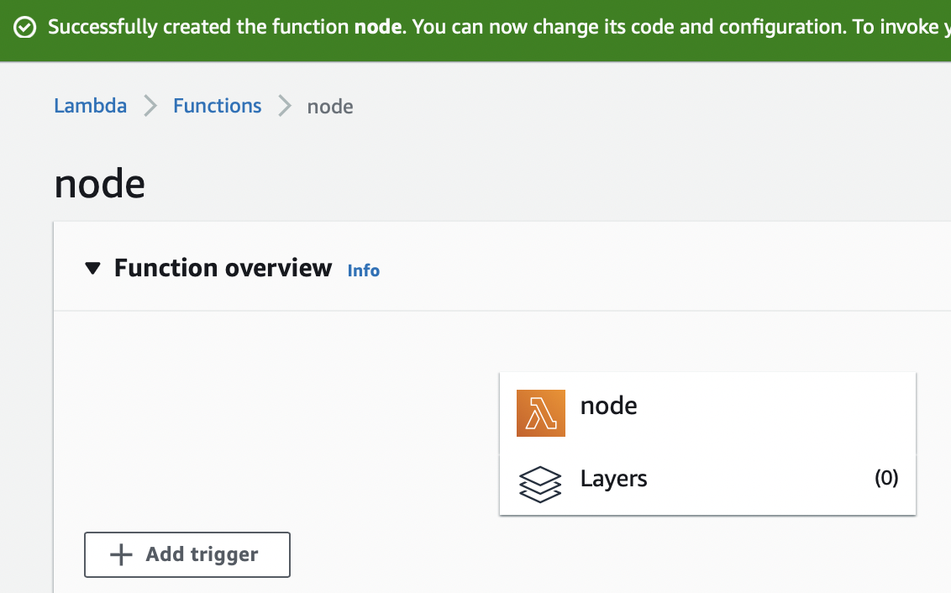
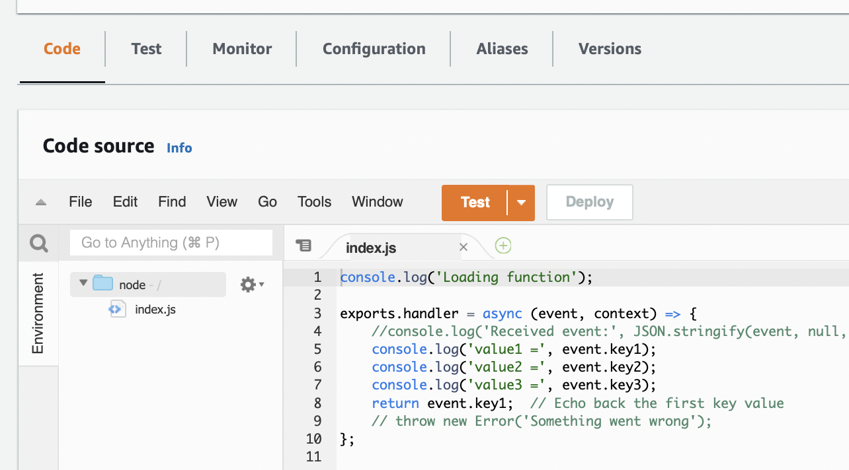
Raw Lambda Function

Slide 16
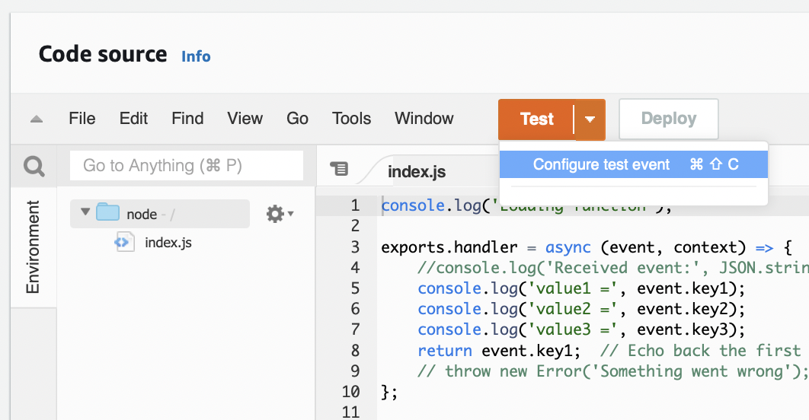
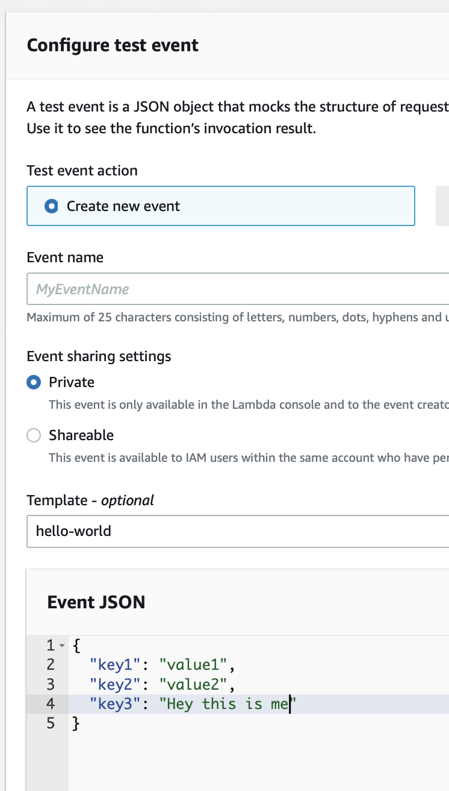
Testing the Function
Create a test scenario
Name your Test Event
Create the JSON object to be sent to the funciton

Slide 17
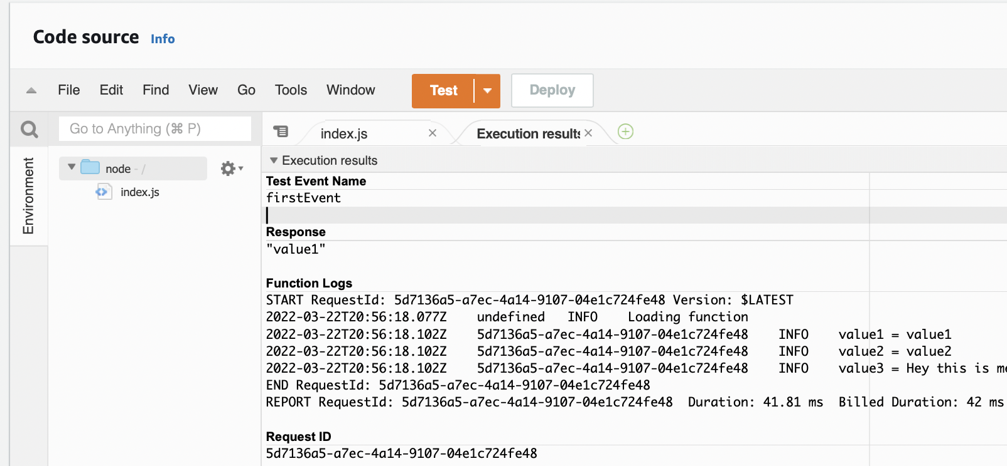

Slide 18
Tutorial – Part Two Quote Application
The second half of the LinkedIn Learning videos heads off in a new direction
You will build a website to create and view quotes
It begins with the last video of section 2: Base Client and Server Setup

Slide 19
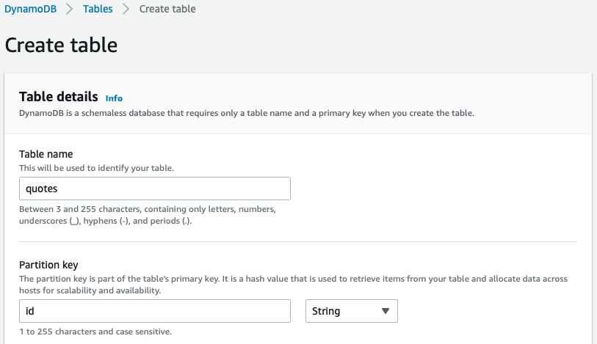
We need a place to save our data
DynamoDB
Table name
Partition key
Key type?

Slide 20
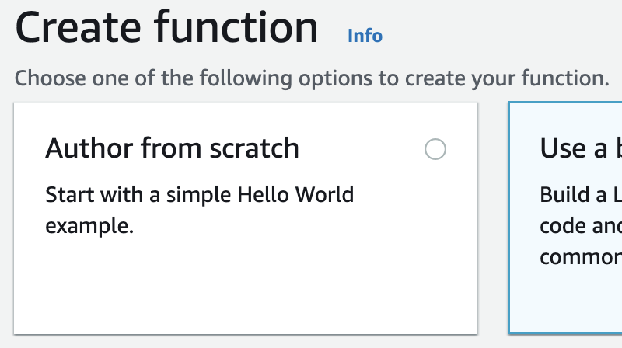
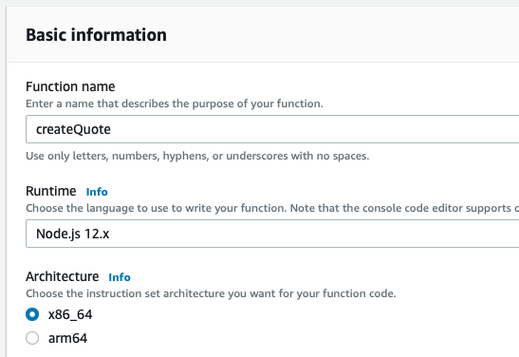
Lambda Functions
Create the function
Author from scratch
Enter the name
Choose the Runtime

Slide 21
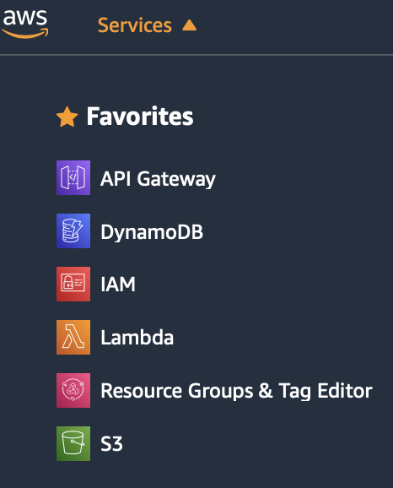
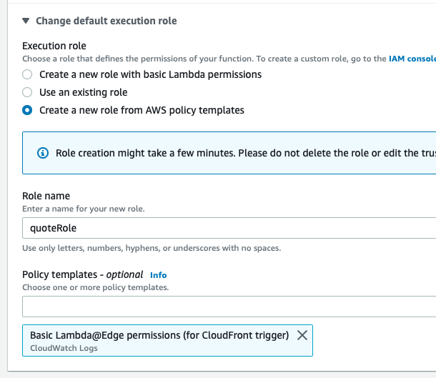
Lambda Functions
Create a new role from AWS policy templates
Role name
Search for and select the Basic Lambda@Edge permissions

Slide 22
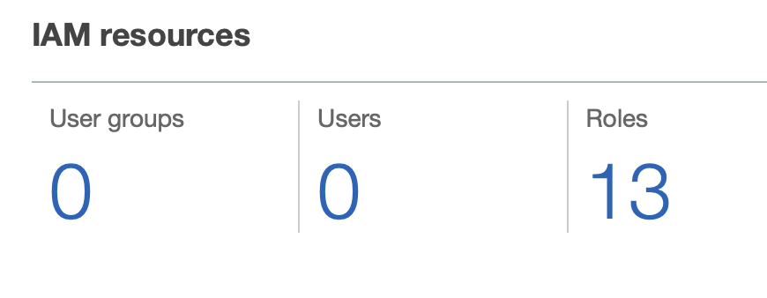
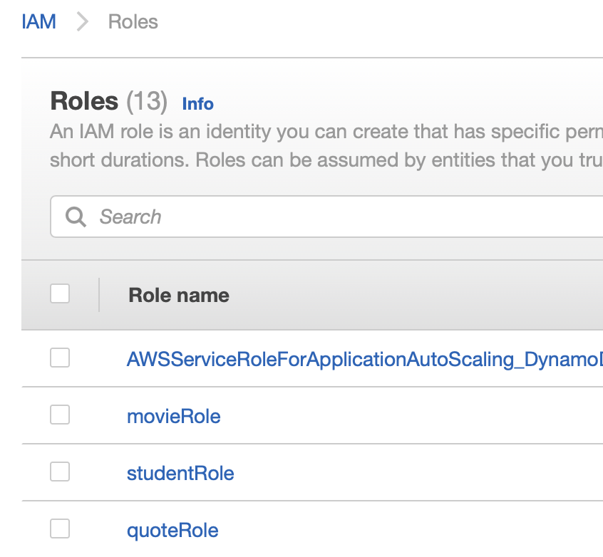
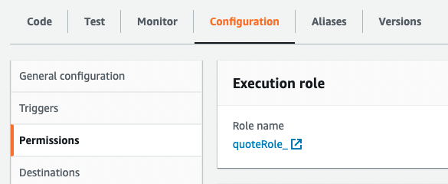
Identity and Access Management
The Role we created needs additional permissions
Let’s go the IAM – Identity and Access Management
Click on Roles
Find the role
You can also get to the role from the Configuration tab for the function
IAM – Assign roles to enable services

Slide 23
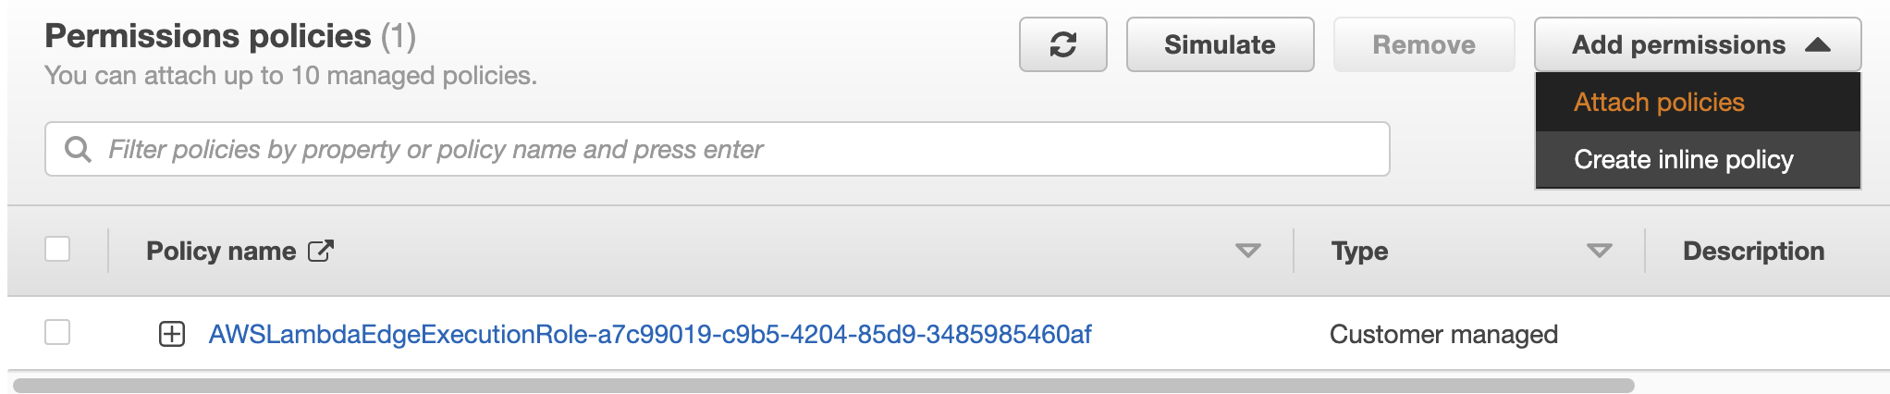
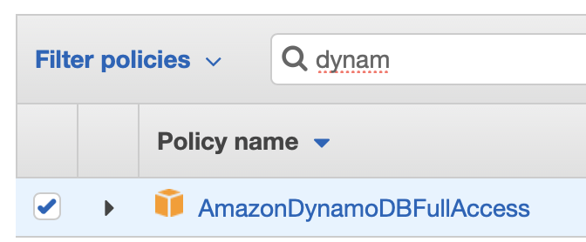
Identity and Access Management
Attach policies
Search for Dynamo
Select AmazonDynamoDBFullAccess

Slide 24
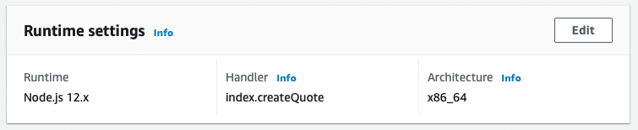
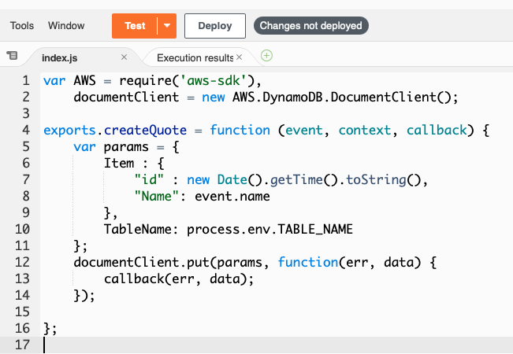
Back to our Lambda Function
Create the code for the function
Remove the default code replace with this code
Edit the Handler name in Runtime settings
Take note of line 10

Slide 25
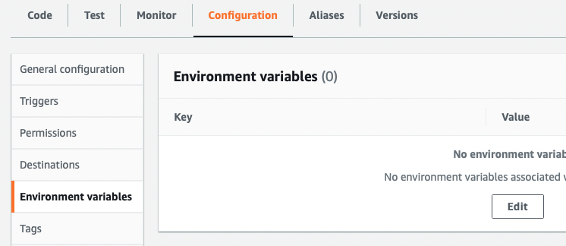
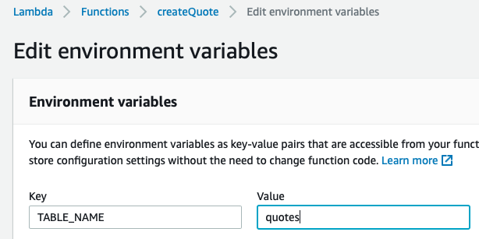
Environment variable
Create an Environment variable
Configuration panel
Environment variables tab
This is not necessary. We could hardcode the Table name, but it is a good opportunity to show the use of environment variables

Slide 26
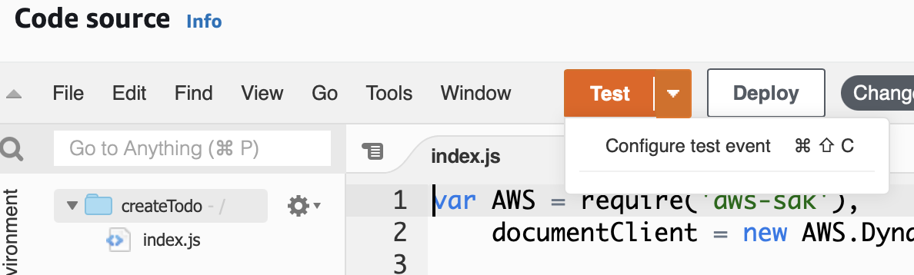
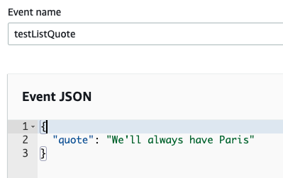
Create a Test
Configure test event
Create the JSON input attributes

Slide 27
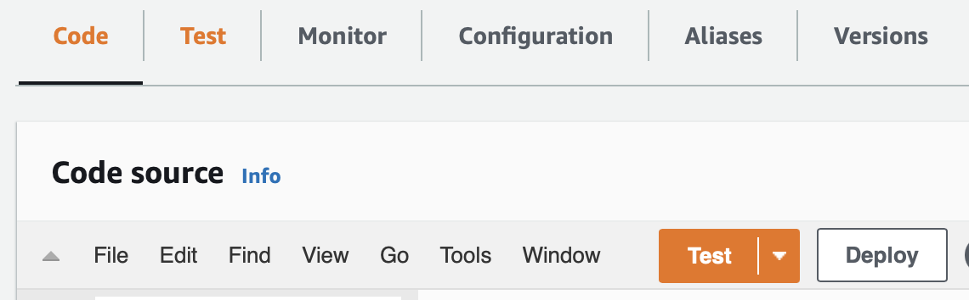
Deploy and Test the code
Click the Deploy button
Click the Test button
The magic happens
Go to DynamoDB page to see that the insert happened

Slide 28
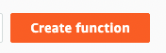
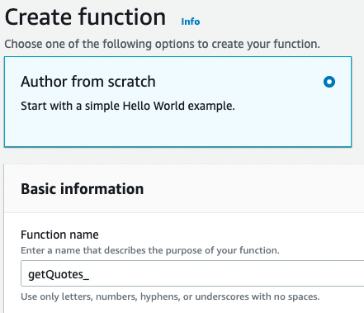
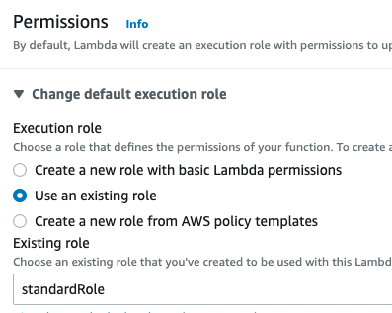
New Lambda Function Get all Quotes
Create the Function
Name it ‘getQuotes’
We already have a useful Role for accessing a DynamoDB table
Let’s reuse it rather that create an identical role

Slide 29
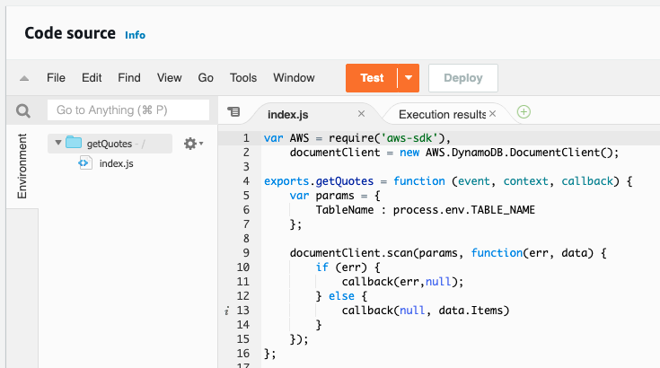
Change Default Code
Code is very similar to the Create function
No event data is requited
Just ‘scan’ the table and return all items
Don’t forget to add the TABLE_NAME environment variable

Slide 30



Create the API Gateway
Create a REST API
Give it a name to match your MVC

Slide 31



Add Methods to the Gateway
Create a Method
Choose the HTTP verb
Associate Action with the Lambda function

Slide 32



Deploy your API Gateway
Deploy API
Define the stage of the API
Now you have a URL for your requests

Slide 33

Postman
Use POSTman to test anything beyond GET
POST, PUT, DELETE

Slide 34



One more Lambda
Create a Delete function
Don’t forget the role
Minor change to the scan function is all we need

Slide 35



Back to the API Gateway
Add the DELETE method

